Slide 1
Summary for Final Exam
Keren Zhu
kerenzhu@cse.cuhk.edu.hk

Slide 2
Logistics
HW 8 is due on April 23
  No late submission for any reason
Tutorials for this week
  Open office hour with TA
Final exam
  May 10, 15:30-17:30 at University Gymnasium
  Same time/venue with A class, but will have different problems
  The instructor cannot attend in person, Prof. Irwin King will help coordinating the exam. The TAs will be in charge of the exam

Slide 3
Final exam format
Two pages of cheetsheets
  Letter or A4 size, double sided
No calculator allowed
100 points possible, 15 problems
  11 multiple choice problems
Your answers shall be written in a 5-page answer booklet
  Use question paper for scratching

Slide 4
Final exam format
The contents before midterm will be covered but won’t be as detailed as the midterm
Emphasize more on the second half semester
  Heap, sorting, hash table, dynamic programing, graph
    3 problems with 15 points are about graph. More on the concept instead of algorithm procedures
Rule of thumbs on reviewing
  Reviewing the homework sets and try some Leetcode problems to get familiar with algorithm design
  Review the lecture slides

Slide 5
Heap
What is a priority queue and what are the representative applications?
Binary heap operations
  The definitions
    What is its capability and its limits (like vs Red-black tree)
    How to tell if a tree/array is a binary heap
  Insert, peek, extract-min in the tree forms
    Complexity and procedure
  Perform the operations in the array form
    Why array format is more efficient than the tree

Slide 6
Heap
How to apply heap in practical problems
  Easy and efficient to keep tracking the extreme values
Note: a one-time heapification (discussed in sorting) is more efficient than iteratively inserting

Slide 7
Sorting
The procedures for insertion sort, heap, merge, quick, bucket, selection and radix sort
  Given an unsorted, you should know how to sort it with a required algorithm
Knows and understand their complexity
  The O(nlogn) lower bound for comparison-based sort
  Understand why bucket, selection and radix can go beyond the O(nlogn) limit.
    What are their limitations?

Slide 8
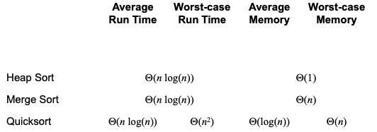
Sorting
Knows and understand their complexity
  Remember the best, worst and average complexity
  Understand in which scenarios will be their best and worst cases

Slide 9
Sorting
When and how to apply sorting to solve practical problems
Note on complexity
  You need to know and understand the intuition of “average” time complexity for sorting and hash table, but the exam won’t ask you to analyze an average time complexity of an algorithm

Slide 10
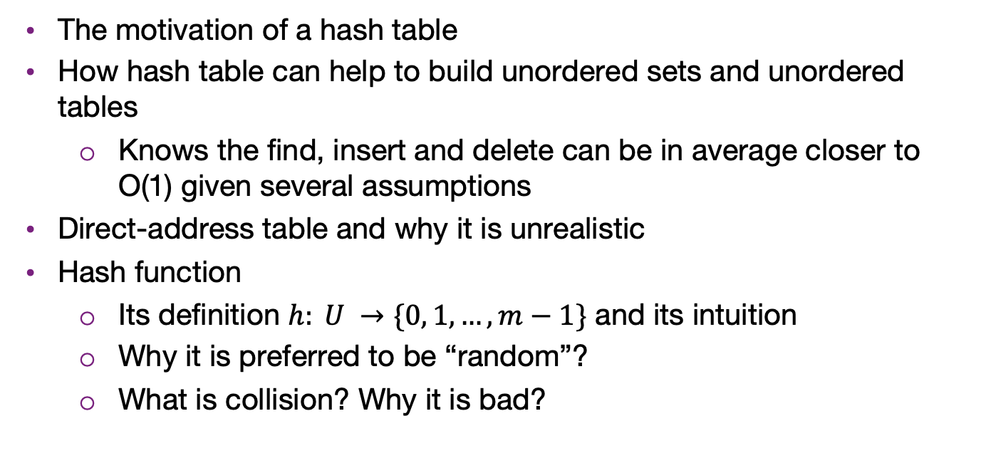
Hash table
The motivation of a hash table
How hash table can help to build unordered sets and unordered tables
  Knows the find, insert and delete can be in average closer to O(1) given several assumptions
Direct-address table and why it is unrealistic
Hash function
  Its definition $h: U →\{0, 1,…, m−1\}$ and its intuition
  Why it is preferred to be “random”?
  What is collision? Why it is bad?

Slide 11
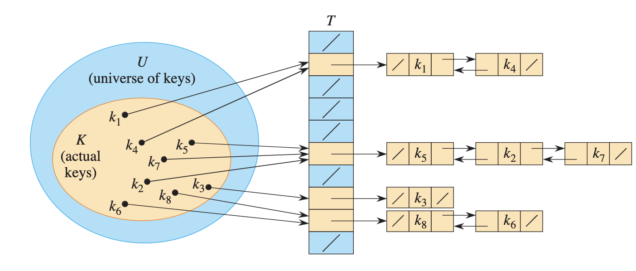
Hash table
Separate chaining
  Its procedure to resolve collision
  Its worst case scenario

Slide 12
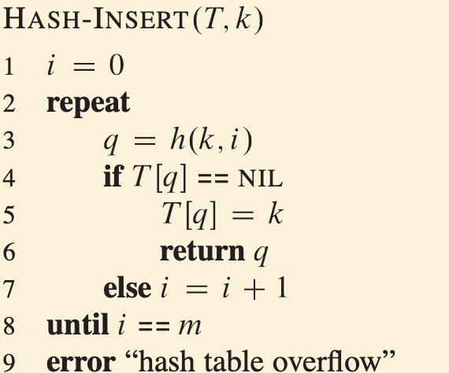
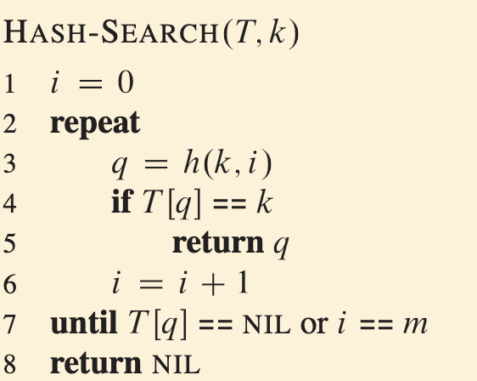
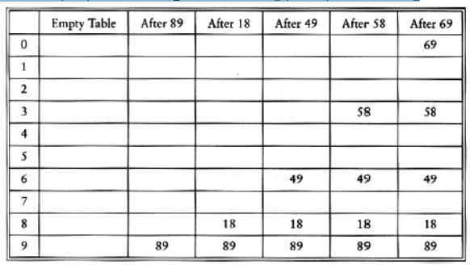

Hash table
Open addressing
  Procedures of insert and find
h$\left(k, i\right)=\left(hash\left(k\right)+f\left(i\right)\right)mod m$, where f(0) = 0
f: collision resolution strategy: linear, quadratic, double hashing
The probe sequence $<h\left(k, 0\right), h\left(k,1\right),…, h(k, m−1)>$
Use DELETED flag for deletion

Slide 13
Hash table
How to apply hash table for practical problems
  When to use hash table for sets/maps/dictionaries
  The requirement and limitation of hash table

Slide 14
Dynamic programming
The basic steps of dynamic programming
Two ways of DP solving
  Top-down memorization
  Bottom-up DP table
Optimal substructure of DP problems
  Compute the problem using the optimal values of its subproblems
  The subproblems overlaps
Procedures of three DP algorithms
  Fibonacci numbers, cutting rod and 0-1 knapsack problem
  Their time and complexity

Slide 15
Graphs
More on the concepts
Basic concepts
  undirected, directed, vertex, edge, degree, sub-graph, path, simple path, connectedness, weighted graphs, trees, forests, sources, sinks, directed acyclic graph
Graph representation
  Know how to convert a graph to/from a binary-relation list/adjacency matrix/adjacency lists
Knows what is DAG and topological ordering
Can perform BFS and DFS on a given graph
Knows we can use DFS to do topological sort

